Slide 1

Where’s My Friends?
Find your friends without having to ask.
Team Surds

Slide 2
Kirsten and Ryan are friends.

Slide 3
Kirsten wants to study with Ryan.

Slide 4
Kirsten asks Ryan where he is.

Slide 5
Ryan is deaf.
He doesn’t see the message.

Slide 6
Kirsten waits 30 minutes.
She doesn’t get a response.

Slide 7
Kirsten doesn’t get to study.
Ryan doesn’t get to study.
They both drop out of university.

Slide 8
Kirsten doesn’t get to study.
Ryan doesn’t get to study.

Slide 9
Kirsten doesn’t get to study.
Ryan doesn’t get to study.
They both drop out of university.

Slide 10

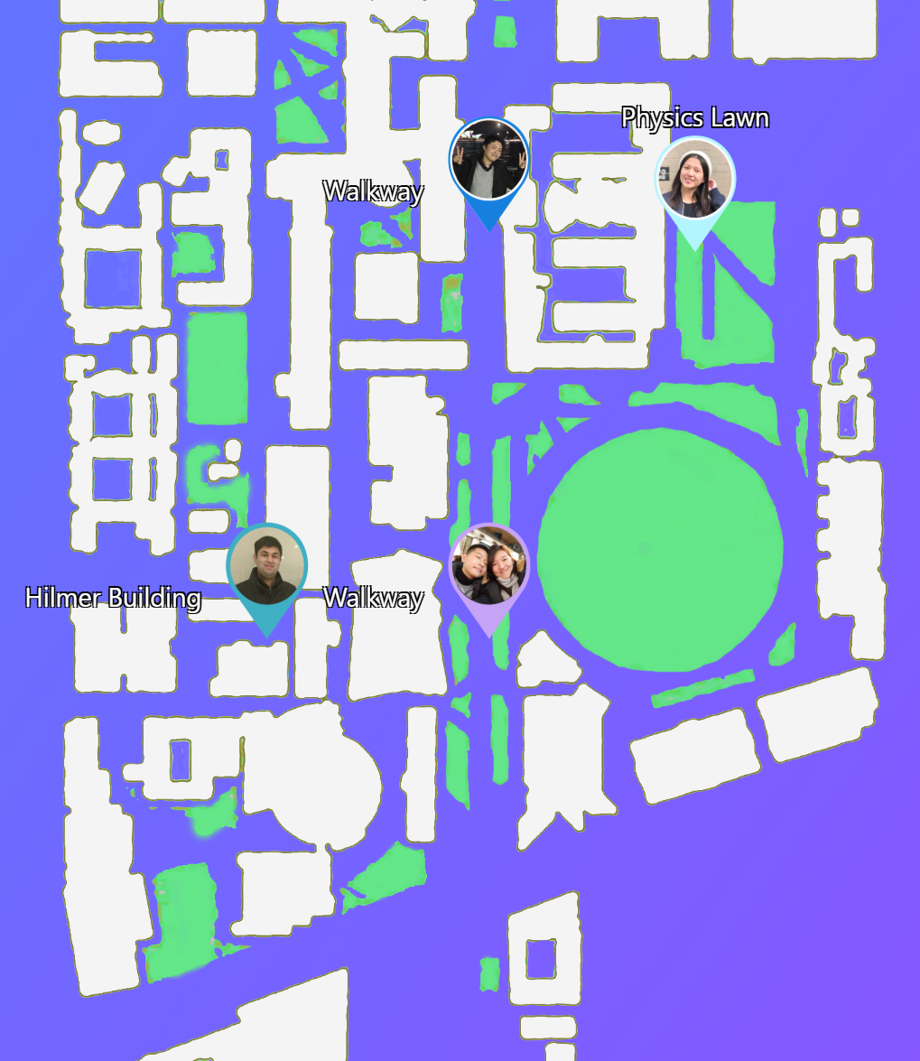
Where’s My Friends?
Find your friends without having to ask.

